Slide 1
Project of Patter Recognition (CSE 4835)
Face Emotion Recognition Using Deep Learning
Member Group :
Tareq Khaled – 170041067
Ahmed Camara - 170041070
Mahamat Djibrine – 170041072
Malick Sow – 170041073
1

Slide 2
Table of Contents
1
Introduction
2
Problem statement
3
Literature Review
4
Dataset
5
Methodology
6
Future Work
2

Slide 3
Introduction
Facial Emotion Recognition (FER) is the technology that analyses facial expressions from both static images and videos in order to reveal information on one's emotional state.
Facial emotion detection and expressions are vital for applications that require credibility assessment, evaluating truthfulness, and detection of deception.
However, most of the research reveal low accuracy in emotion detection mainly due to the low quality of images under consideration.[1]
Conducting intensive pre-processing activities and using artificial intelligence especially deep learning techniques are increasing accuracy in computational predictions.
3

Slide 4

Problem Statement
With improved and advanced image detection and processing technologies, accurate emotion detection seems fairly achievable.
In reality, images taken with different backgrounds, color settings and poses are challenging to the existing emotion detection algorithms.
However, deep learning technologies have made great progress in the field of emotion detection.
4

Slide 5
Literature Review
“Face Emotion Detection Using Deep Learning“ [2]
In this paper, they have used deep learning algorithm to identify the basic human emotions (e.g., anger, fear, neutral, happy, sad, surprise, etc.) on multiple datasets, including FER-2013 and CK+
Experiment architecture have convolution operation , Batch normalization ,ReLU ,Max pooling
The accuracy for model is 60% for FER 2013 dataset, and for 99.1% for CK+ using CNN model
The reason behind this low performance on FER2013 is that some classes have more images samples than others hence feature extraction more challenging
Can be improved by adding more convolutional , dense layers and by changing some hyper-parameters
2021 2nd International Conference on Advances in Computing, Communication, Embedded and Secure Systems (ACCESS)
5

Slide 6
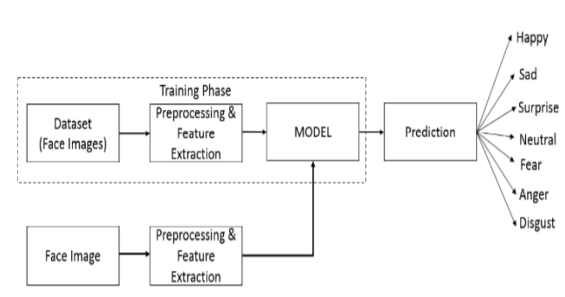
Proposed Architecture
6

Slide 7
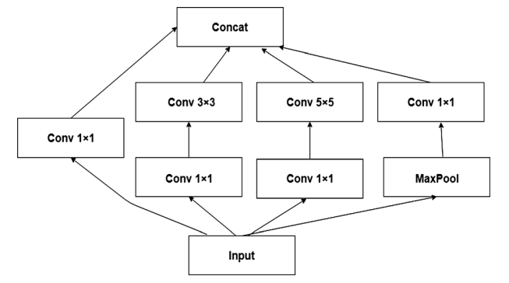
Literature Review
“ Robust real-time emotion detection system using CNN architecture “ [3]
In this paper they proposed a CNN-based model and compared its computation cost and efficiency over 8 different datasets to ensure its robustness.
One of the dataset they used is Fer2013, and achieved around
65% accuracy
Used Inception module to reduce dimensionality and showing
use of 1*1 convolutions
Neural Computing and Applications : https://doi.org/10.1007/s00521-019-04564-4
7

Slide 8
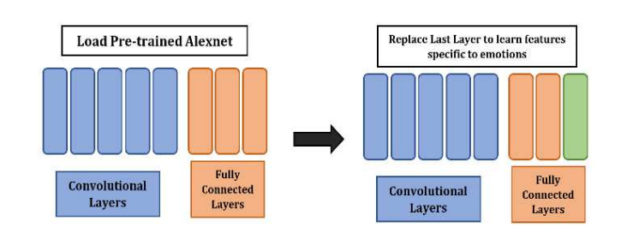
Literature Review
“ Facial Emotion Recognition Using Transfer Learning of AlexNet “ [4]
Major paper contributions includes:
Image Augmentation,
Transfer learning of the Alexnet model
Early stopping for overfitting ,
Finetuned-Alexnet outperforms the other state-of-the-art methods.
Their proposed framework achieved the accuracy of 99.44% and 66.20% for the CK+ dataset and the FER dataset
2021 9th International Conference on Information and Communication Technology (ICoICT)
8

Slide 9
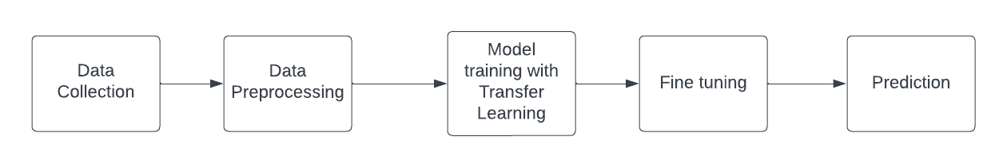
Five Phases
Figure: Five Phases of Our Project
9

Slide 10
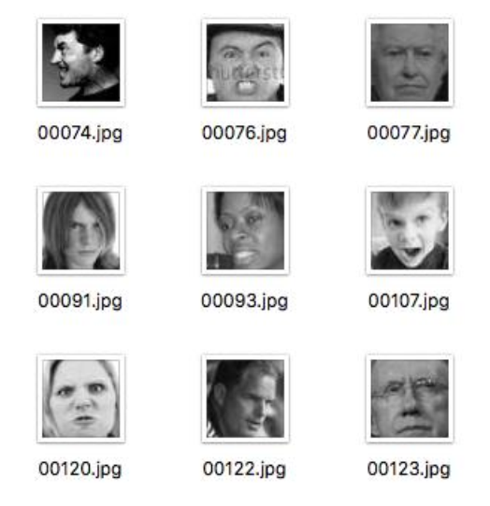
Dataset
Dataset name : FER-2013 (Facial Expression Recognition 2013)
Collect from Kaggle [4]
Content 7 face emotions , namely Angry, Disgust, Fear, Happy, Sad, Surprise, and Neutral
We used 22,968 images for the training phase, and 5,741 for the validation phase. The test dataset consists of 7,178 images.
10

Slide 11
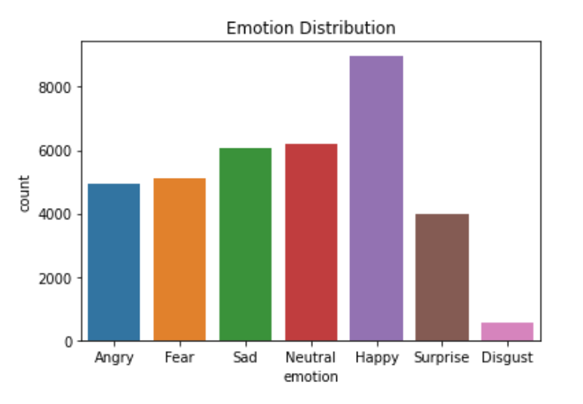
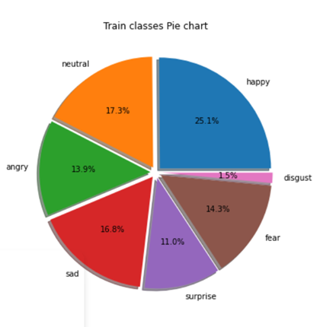
Challenge in dataset :
Problem:
Imbalance Dataset
11

Slide 12
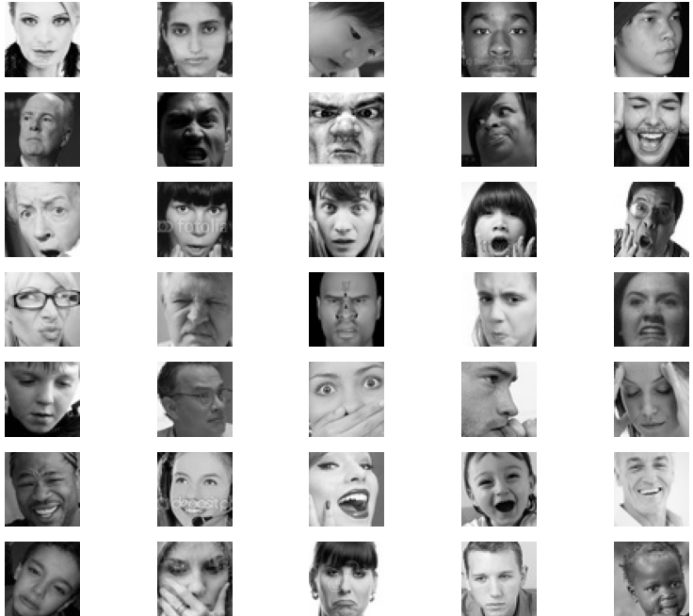
Challenge in dataset :
1- The images have a low resolution.
2- The faces are not in the same position.
3- Some images have text written on them.
4- Some people hide part of their faces with
their hands.
12

Slide 13
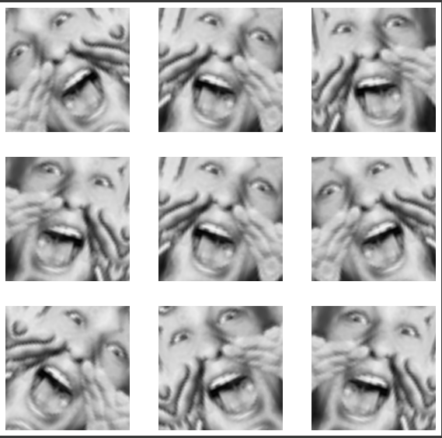

Data Pre-processing
1) Data Pre-processing:
Rescale the pixel into the appropriate format to match with the model’s expectation.
2) Data Augmentation:
The RandomFllip function helps us to flip the images.
The RandomRotation is a useful augmentation in particular
because it changes the angles that objects appear in the dataset
during training. Should only be used during learning.
13

Slide 14
Methodology: Transfer Learning & Fine-tuning
Transfer Learning: is the technique of using an already pre-trained model on our data for a specific problem.
Construct EfficientNetB1 model
Train model on the top layer
Un-freezing bigger part of the network
Re-train model on the bigger network
14

Slide 15
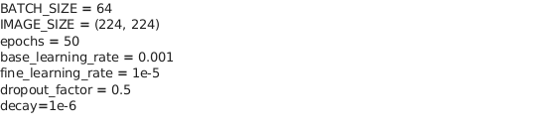
Hyper parameters && parameters
The parameters used to train the model are given below :
15

Slide 16
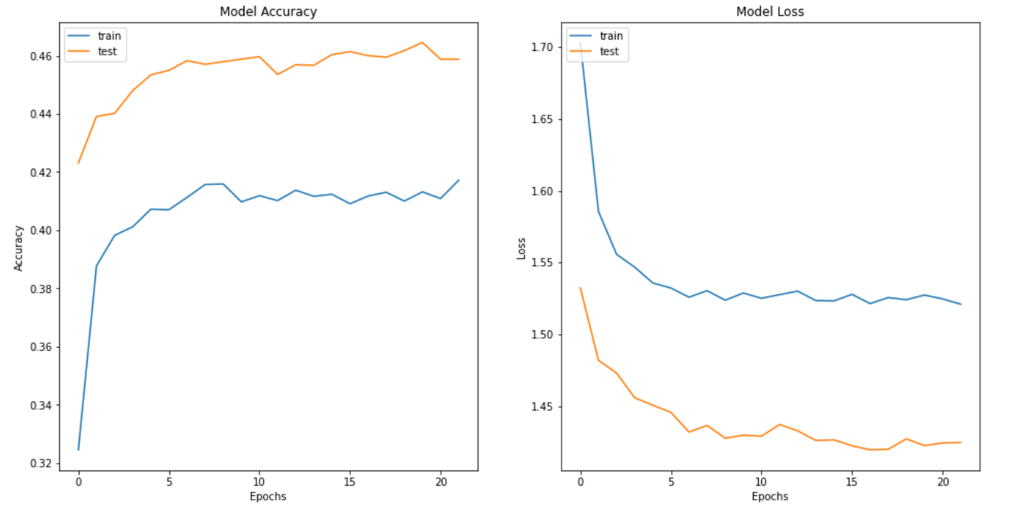
Result Analysis: Transfer Learning
The first phase which consisted of training the model on only the top layers gave us an accuracy of 45%.
16

Slide 17
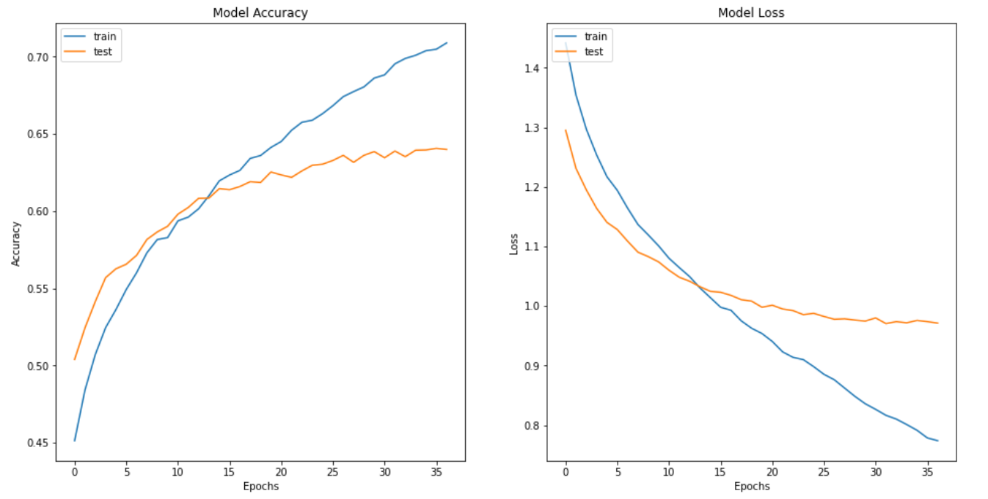
Result Analysis: Fine-tuning
Then when doing the fine tuning we were able to reach an accuracy of 64% for the validation data
17

Slide 18
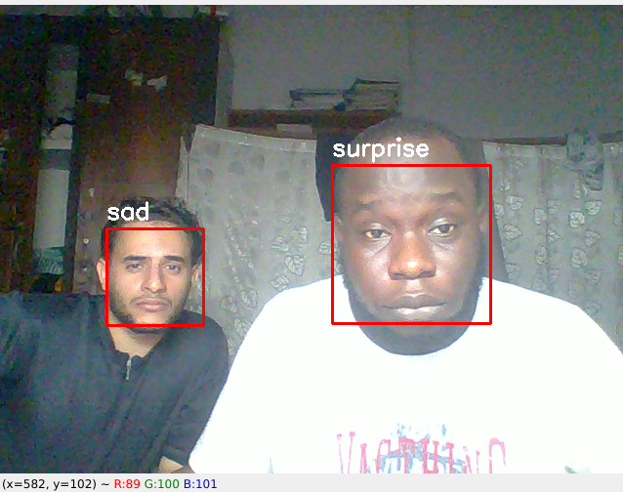
Real Time Emotion Detection
Using open source python libraries such as OpenCV-python, the detector was created and here are few results from locally testing the application.
18

Slide 19
Conclusion
Facial Emotion Recognition (FER) is the technology that analyses facial expressions from both static images and videos in order to reveal information on one's emotional state.
Using Data preprocessing and data augmentation for handling imbalance dataset
We train Transfer Learning model to get 45% accuracy after we done Fine-tuning in model we could achieved 64% accuracy.
We implement Real Time Emotion Detection by using OpenCV-python.
19

Slide 20
Future Work
Using different optimization techniques.
Try out more different hyper parameters tuning.
Explore other techniques to deal with imbalance dataset.
Increase model architecture to extract complex features..
More data preprocessing.
20

Slide 21
Reference
[1] Illiana Azizan and Fatimah Khalid, “Facial Emotion Recognition: A Brief Review”, ICSETM -2018 [2] Pradnya Kedari and Mihir Kapile, Divya Kadole , and Sagar Jaikar “Face Emotion Detection Using Deep Learning”, 2021 (ACCESS).
[3] Sarmela A/P Raja Sekaran , Chin Poo Lee and Kian Ming Lim “Facial Emotion Recognition Using Transfer Learning of AlexNet” 2021 (ICoICT).
[4] Shruti Jaiswal , G. C. Nandi “Neural Computing and Applications” : https://doi.org/10.1007/s00521-019-04564-4
[5] https://www.kaggle.com/datasets/msambare/fer2013
21

Slide 22

Thank You
22

